Slide 1
Object Oriented Programming 2 Section 5
Unit 13: Menus and TextFields
Unit 14: arrays of objects Unit 15: structuring an event-driven record-keeping system

Slide 2
Unit 13: Objectives
Distinguish between menu bars, menus and menu items
Add a menu bar and menus to a window
Add menu items to menus, and process selections from them appropriately
Compare Strings correctly using .equals() and .equalsIgnoreCase() methods
Use JLabels, JTextFields and JTextAreas to display text, and process ActionEvents from text fields correctly
Use Fonts to improve the appearance of a GUI
Notes:
Almost all nontrivial GUI programs support menus. By using these three menu-related classes, we can easily add menus to our Java programs.

Slide 3
Sample Programs
JMenuFrame.java
TextAreaExample
TextFieldLabelExample
StringTest1, 2 and 3
For labs MyJFrame 1 to 4
Textbook sections:
Horstmann Chapter 11

Slide 4
Menus
The javax.swing package contains three menu-related classes: JMenuBar, JMenu, and JMenuItem.
JMenuBar is a bar where the menus are placed. There is one menu bar per frame.
JMenu (such as File or Edit) is a group of menu choices. A menu bar may include many JMenu objects.
JMenuItem (such as Copy, Cut, or Paste) is an individual menu choice in a JMenu object.
Only the JMenuItem objects generate events.
Notes:
Almost all nontrivial GUI programs support menus. By using these three menu-related classes, we can easily add menus to our Java programs.

Slide 5
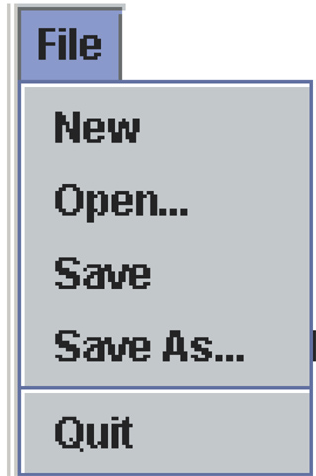
Menu Components
Edit
View
Help
JMenuBar
File
Edit
View
Help
JMenu
JMenuItem
separator
Notes:
The diagram shows how the menu-related objects correspond to the actual menus.

Slide 6
Sequence for Implementing Menus
Create a JMenuBar object and attach it to a frame or content pane: setMenuBar(myBar);
Create a JMenu object.
Create JMenuItem objects and add them to the JMenu object.
Add the JMenu object to the JMenuBar object.
Repeat for other menus
Process the action handling
Notes:
This is not the only valid sequence. Other sequences are possible. We list this sequence as one possible sequence you can follow in creating menus.

Slide 7
class JMenuFrame extends JFrame implements ActionListener
public JMenuFrame() {
Container cPane;
cPane = getContentPane( );
//create two menus and their menu items
createFileMenu();
createEditMenu();
//and add them to the menubar
JMenuBar menuBar = new JMenuBar();
setJMenuBar(menuBar);
menuBar.add(fileMenu);
menuBar.add(editMenu);
setDefaultCloseOperation(EXIT_ON_CLOSE);
}

Slide 8
Creating the file menu items
private void createFileMenu( ) {
JMenuItem item;
fileMenu = new JMenu("File");
item = new JMenuItem("New"); //New
item.addActionListener( this );
fileMenu.add( item );
item = new JMenuItem("Open..."); //Open...
….
fileMenu.addSeparator(); //add a horizontal separator line
// create and add more menu items here
}

Slide 9
Exercise
Add a menu bar to your Bicycle Frame which has a menu called File and a menu called Bicycle. The File menu should contain the items ‘New File’ and ‘quit’ for the moment. The Bicycle menu should contain ‘Add New Bicycle’ and ‘Display’.

Slide 10
Handling menu selections
public void actionPerformed(ActionEvent event) {
String menuName;
menuName = event.getActionCommand();
if (menuName.equals("Quit")) {
System.exit(0);
}
else {
JOptionPane.showMessageDialog(null,
"Menu Item '" + menuName + "' is selected.");
}
}

Slide 11
Comparing Strings
Strings are objects: they are instances of class String and have methods associated with them
getActionCommand() returns a String object: to compare this correctly to a fixed String like “Quit”, you must use the .equals() method, not the ‘==‘ operator

Slide 12
Comparing Objects
With primitive data types, we have only one way to compare them, but with objects (reference data type), we have two ways to compare them.
We can test whether two variables point to the same object (use ==), or
We can test whether two distinct objects have the same contents (use .equals()).
Notes:
Comparing primitive data types is straightforward because there's only one way to compare them. Comparing objects is a little trickier because we can compare them in two different ways.

Slide 13
Using == With Objects (StringTest 1)
String str1 = new String("Java");
String str2 = new String("Java");
if (str1 == str2) {
System.out.println("They are equal");
} else {
System.out.println("They are not equal");
}
They are not equal
Not equal because str1 and str2 point to different String objects.
Notes:
When we use the equality operator (==), we can comparing the contents of the variables str1 and str2. So str1 == str2 being true means the contents are the same, which in turn, means they are pointing to the same object because the content of a reference data type is an address. Therefore, if there are two distinct objects, even the values hold by these objects are the same, the equality testing by the equality operator will always result in false.

Slide 14
Using == With Objects (StringTest 2)
String str1 = new String("Java");
String str2 = str1;
if (str1 == str2) {
System.out.println("They are equal");
} else {
System.out.println("They are not equal");
}
They are equal
It's equal here because str1 and str2 point to the same object.

Slide 15
Using equals with String : StringTest3
String str1 = new String("Java");
String str2 = new String("Java");
if (str1.equals(str2)) {
System.out.println("They are equal");
} else {
System.out.println("They are not equal");
}
They are equal
It's equal here because str1 and str2 have the same sequence of characters.
Notes:
To compare whether two String objects have the same sequence of characters, we use the equals method. This method checks for the case. If we want to compare String objects case-insensitively, then we use the equalsIgnoreCase method.

Slide 16
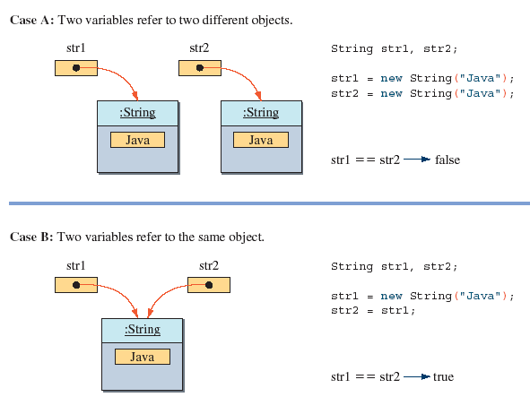
The Semantics of ==

Slide 17
Remember:
Any time you wish to compare 2 Strings, in an ‘if’ or in a loop controlled by sentinel, use one of these methods:
equals()
equalsIgnoreCase()

Slide 18
Examples of comparing Strings
if (e.getActionCommand().equals(“Quit”)) {
System.exit(0);
}
name = JOptionPane.showInputDialog(“Name:
STOP to exit”);
while (! (name.equalsIgnoreCase(“Stop”) {
address = JOptionPane. showInputDialog(
“Enter Address”);
….
}

Slide 19
Exercise
Add action handling to your BicycleFrame so that when you click on a menu item, a dialog pops up telling you that that item is not implemented yet – eg if you click ‘display’ it should say ‘display not implemented yet’.

Slide 20
GUI Classes for Handling Text
The Swing GUI classes JLabel, JTextField, and JTextArea deal with text.
A JLabel object displays uneditable text (and/or an icon).
A JTextField object allows the user to enter a single line of text.
A JTextArea object allows the user to enter multiple lines of text. It can also be used for displaying multiple lines of uneditable text.
Notes:
Notice that JLabel objects are not limited to text. Using them is actually the easiest and quickest way to display an image. JTextArea has dual pursposes. It can be used to display noneditable multi-line text, similar to using multiple JLabel objects. It can also be used to allow the user to enter multiple lines of text, similar to using multiple JTextField objects.

Slide 21
JTextField
We use a JTextField object to accept a single line to text from a user. An action event is generated when the user presses the ENTER key.
The getText() method of JTextField is used to retrieve the text that the user entered.
JTextField input = new JTextField( );
input.addActionListener(eventListener);
contentPane.add(input);
Notes:
The getText method is most commonly used inside the actionPerformed method of an action listener.

Slide 22
JLabel
We use a JLabel object to display a label.
A label can be a text or an image, or both.
When creating an image label, we pass an ImageIcon object instead of a String.
JLabel textLabel = new JLabel("Please enter your name");
contentPane.add(textLabel);
JLabel imgLabel = new JLabel(new ImageIcon(“cat.gif"));
contentPane.add(imgLabel);
Notes:
A JLabel is strictly for displaying noneditable text or image. A JLabel object does not generate any events.

Slide 23
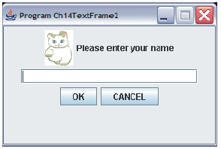
Program TextFieldLabelExample
JLabel
(with a text)
JLabel
(with an image)
JTextField
Notes:
The sample Ch7TextFrame2 class includes five GUI components: two JLabel objects, one JTextField object, and two JButton objects.

Slide 24
ImageIcons
Icon myImage = new ImageIcon(“Cat.gif”); is a quick way to construct an Icon for a button, label or title bar
Files of types .gif, .jpg and .png will work
Bitmaps won’t: use a graphics package to convert them to appropriate format
The image file should be in the same folder as the java file, or a full path given

Slide 25
JTextArea
We use a JTextArea object to display or allow the user to enter multiple lines of text.
The setText method assigns the text to a JTextArea, replacing the current content.
The append method appends the text to the current text.
JTextArea textArea
= new JTextArea( );
. . .
textArea.setText("Hello\n");
textArea.append("the lost ");
textArea.append("world");
Hello
the lost world
JTextArea
Notes:
Notice how the append method works. If you want to place the text to be appended on a new line, you have ouput the newline control character \n at the appropriate point.

Slide 26
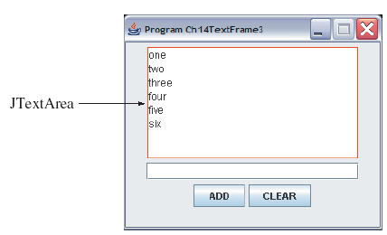
Program TextAreaExample
The state of a TextAreaExample window after six words are entered.
Notes:
Run the program and explore it. This frame has one JTextField object and one JTextArea object. Every time a text is entered in the text field and the ENTER key is pressed or the ADD button is clicked, the entered text is append to the text area. The border of red color is adorned to the text area to demarcate the region.

Slide 27
Adding Scroll Bars to JTextArea
By default a JTextArea does not have any scroll bars. To add scroll bars, we create the JTextArea with a fixed number of rows and columns, and place it in a JScrollPane.
JTextArea textArea = new JTextArea(8,22);
. . .
JScrollPane scrollText = new JScrollPane(textArea);
. . .
contentPane.add(scrollText);
Notes:
Here's a sample to wrap the text area with scroll bars.

Slide 28
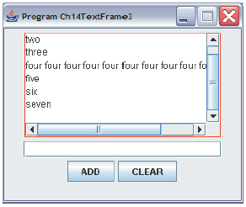
TextAreaExample with Scroll Bars
Notes:
Initially, there will be no scroll bars. Run the program and confirm this behavior. When the displayed text goes beyond the horizontal or vertical boundary, the corresponding scroll bar appears.

Slide 29
Changing the default Font
Change the Font of a component as follows:
Font myFont = new Font( “Font name”, Font.STYLE, fontSize);
textArea.setFont(myFont);
STYLE can be Font.PLAIN, Font.BOLD or Font.ITALIC
fontSize is an int representing point size, eg 14 or 32
Which font names will work depends on the fonts installed on the computer, but the following will always work:
“Monospaced”, “Serif” and “SansSerif”

Slide 30
Exercise
Investigate the Font class
Change the fonts on the buttons, on the prompt label and in the text field in TextFieldExample – use different fonts for each one
Change the foreground and background colours as well for these objects, and for the Frame itself
Remember: less is better, where colour is concerned

